Slide 1

Notes:
30 seconds

Slide 2
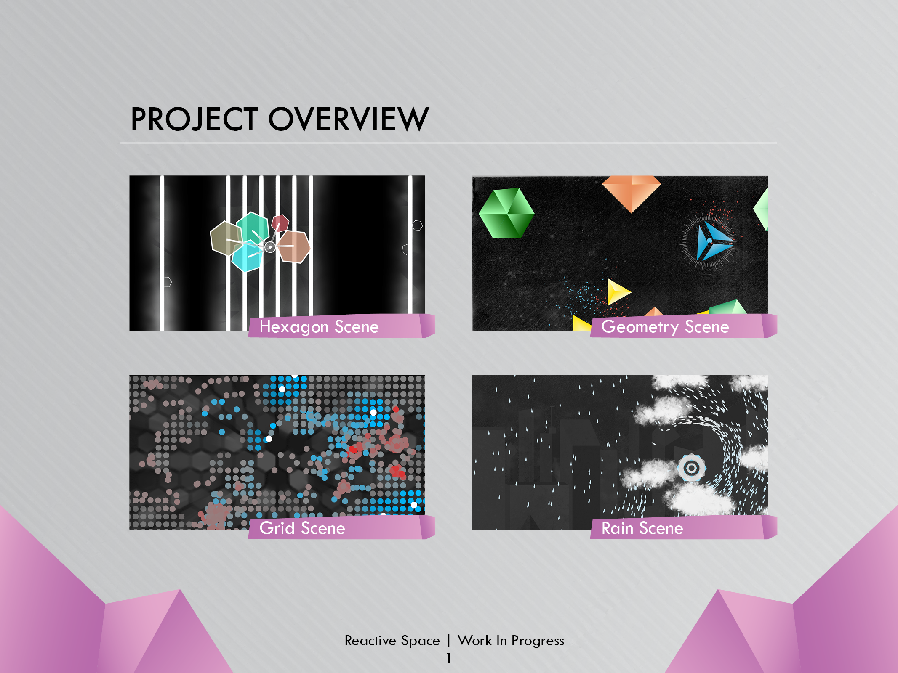
Notes:
We wanted to create an interactive art installation, Something without any real objective, just for fun, that can be enjoyed by anybody
To be installed in a public area
REACTIVE SPACE
Passive and active users
Kinect and openCV
Talk about include 4 scenes
-2 minutes

Slide 3
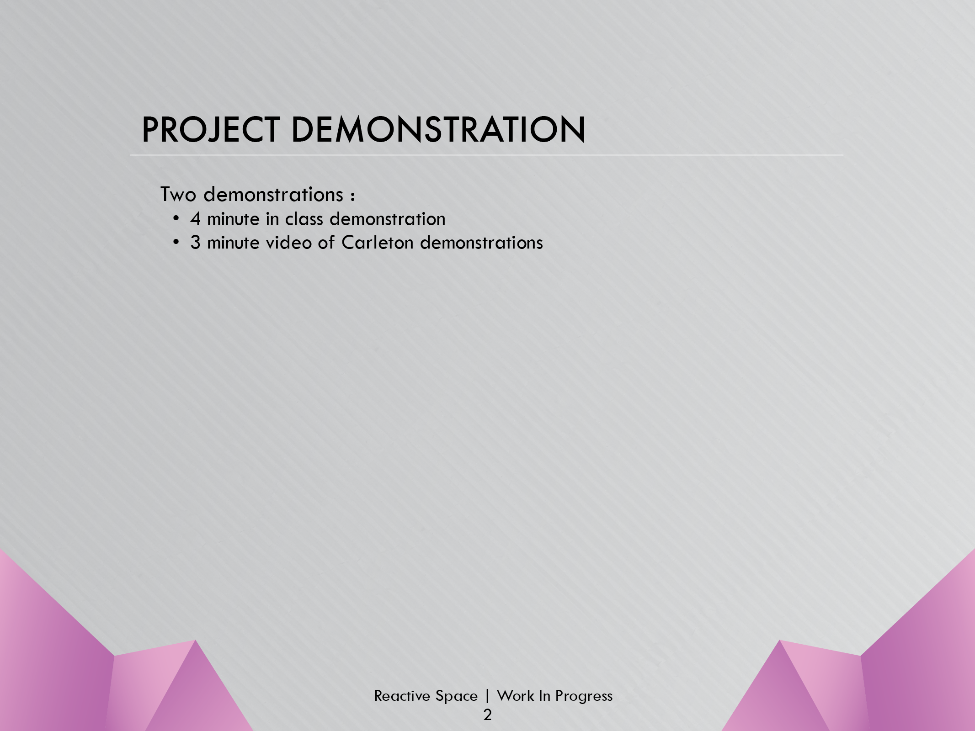
Notes:
Grid – Ryan
active users: affect the mood of the particles
Passive: white dots
Hexagon – Zara
active: Hexagons connected to the hand circles
Change color and grow
lights “turn on” when hexagons are hovering over
Rain – Marco
Active: Hands control the rain
Passive: clouds
Geo – Matt
Active: timer that explodes shapes
Passive: moves shapes around
6 minute – done speaking
9 minutes – done video

Slide 4
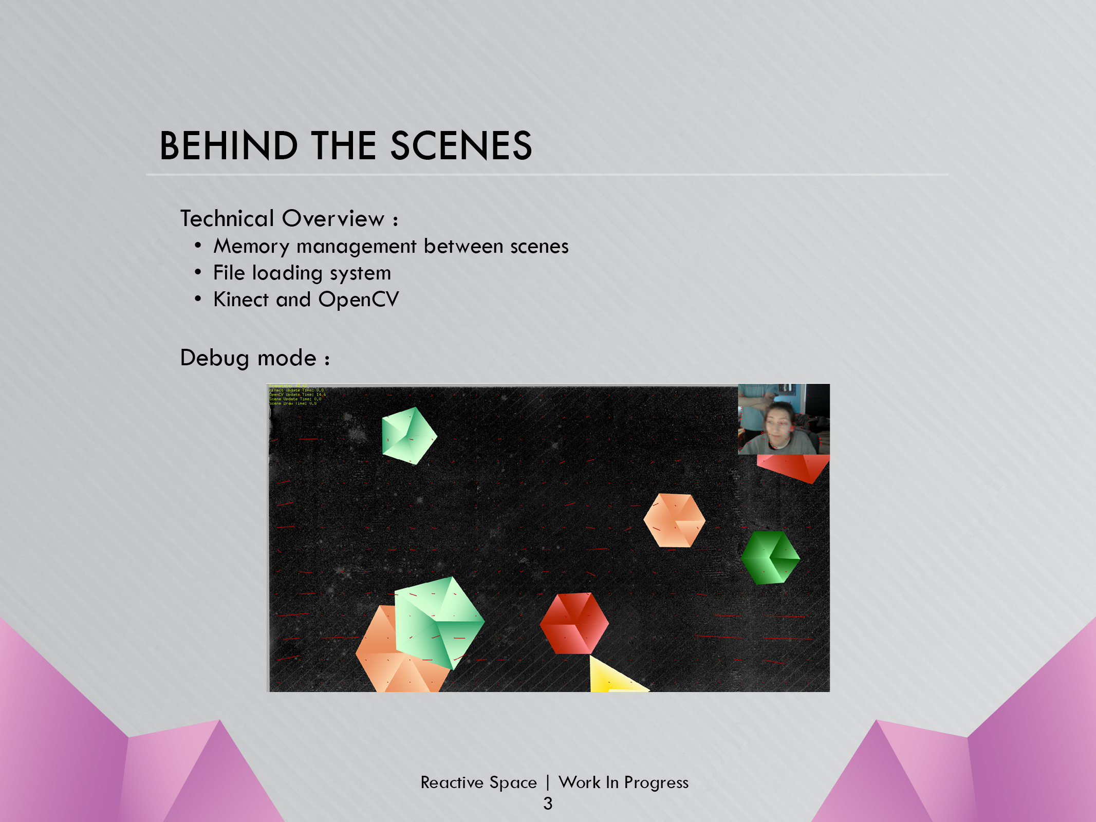
Notes:
share particle data
each scene, different data
Create base class
store in vector of base class
Convert so necessary data
Image loader for resizing
Kinect was easy, OpenCV was a challenge
Vectors from pixel movement
Vector field
-10 minute mark

Slide 5
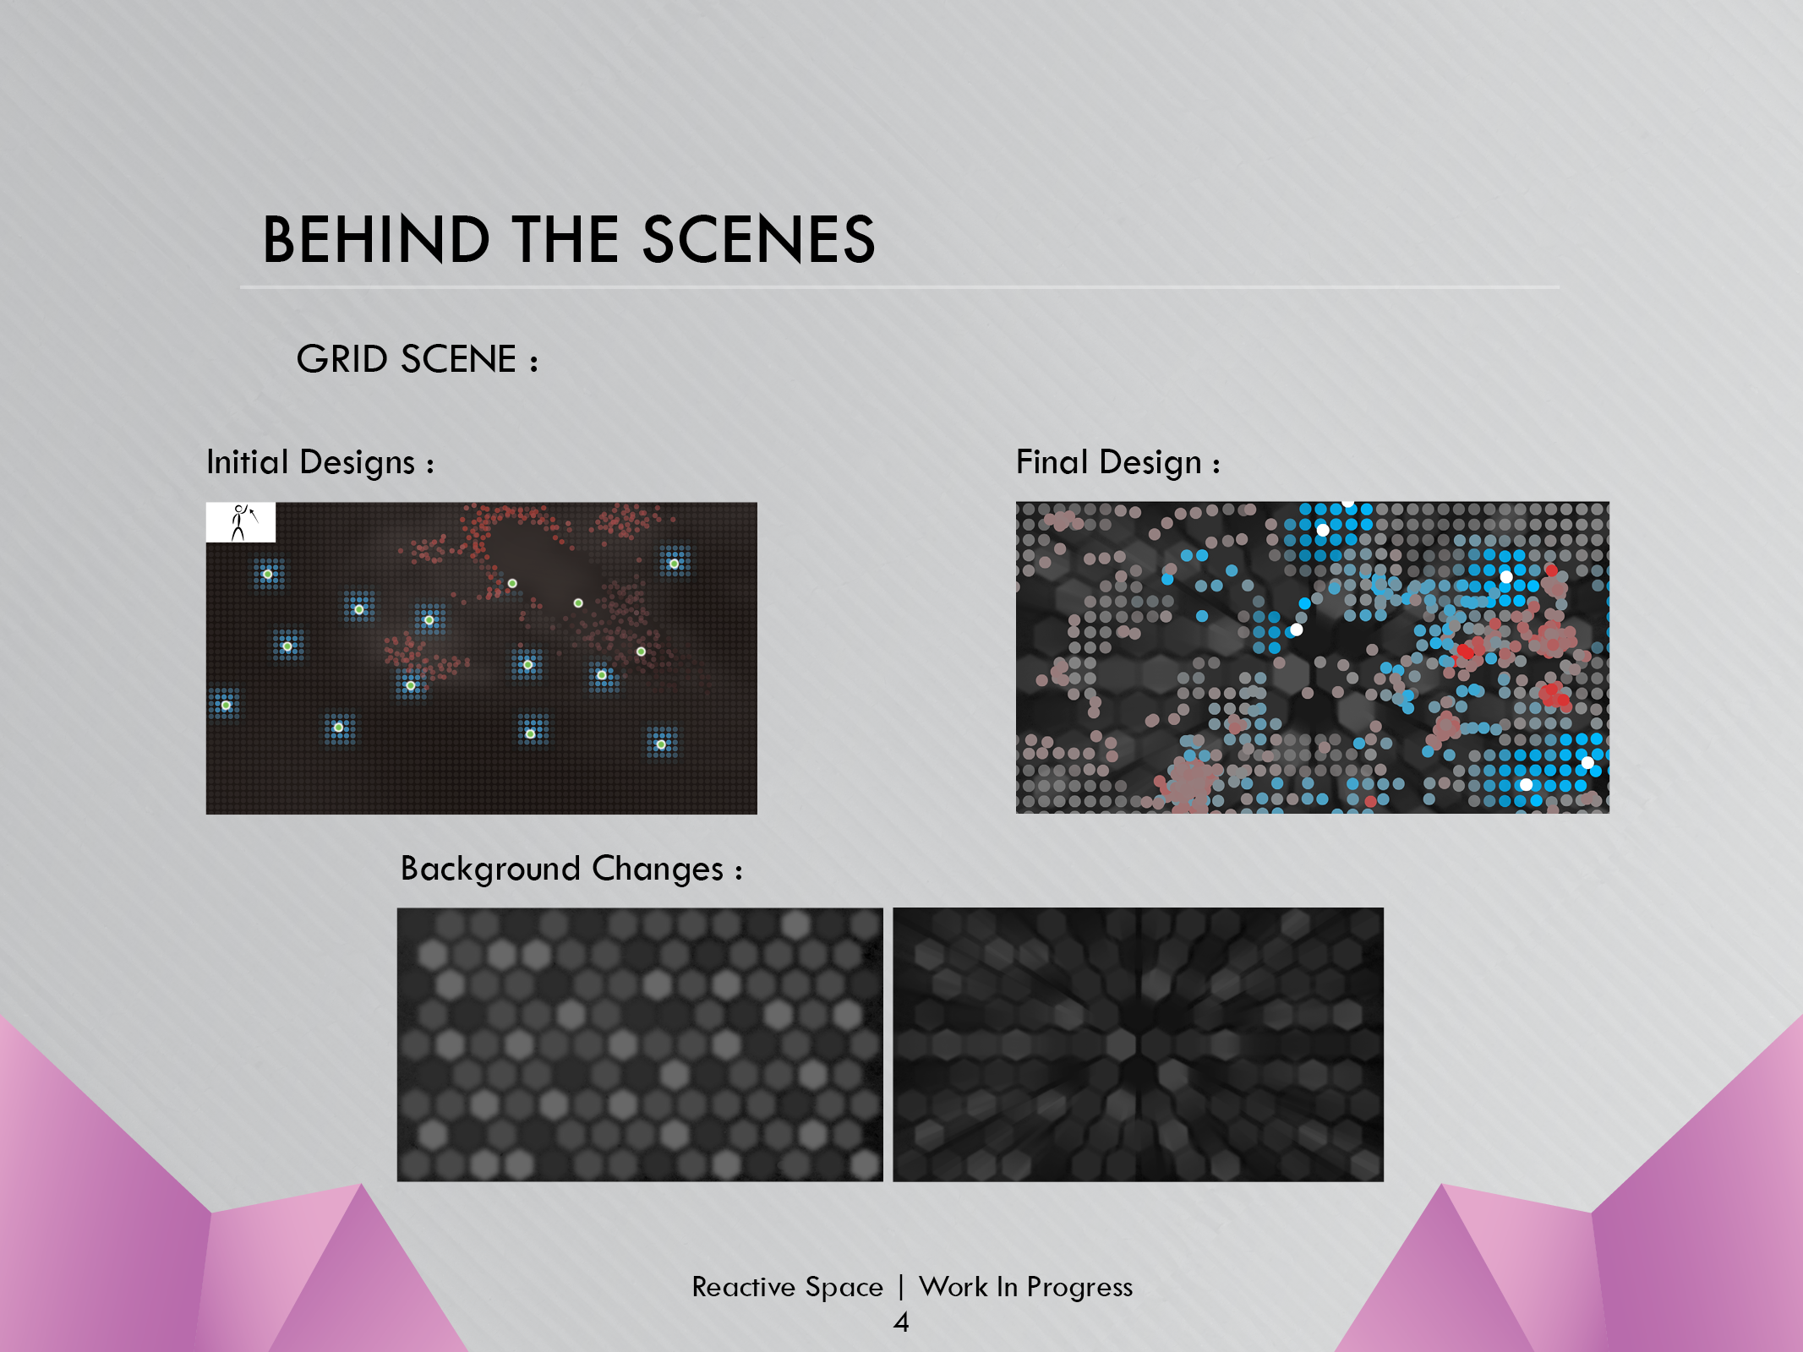
Notes:
Art
-Change background image
Tech
Writing a shader
Low level/raw openGL calls
Flocking system, same as in class
11 minute

Slide 6
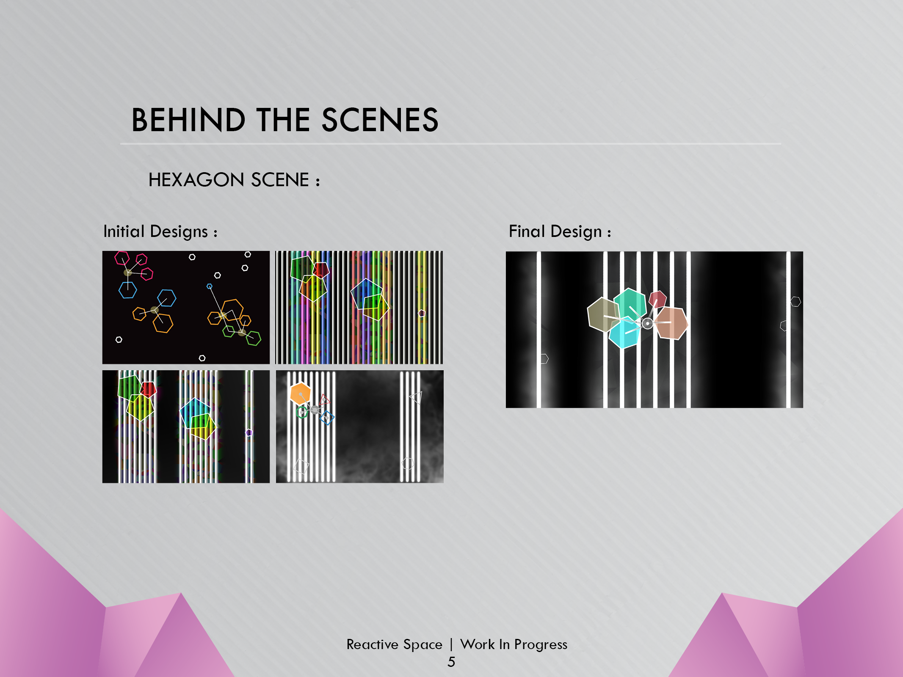
Notes:
Art
-Started as just hexagons in a black space
Different lights, adding in fog
Tech
How to change the hexagon colour
Shader or tinted image
Drawing the lines from the hexagons to the hand
Issue of drawing over the lines
Fog, frame buffer (our own buffer)
Alpha mask for lights
Draw masks to a frame buffer
Draw background and fog with multiplied blending onto mask
12 minute

Slide 7
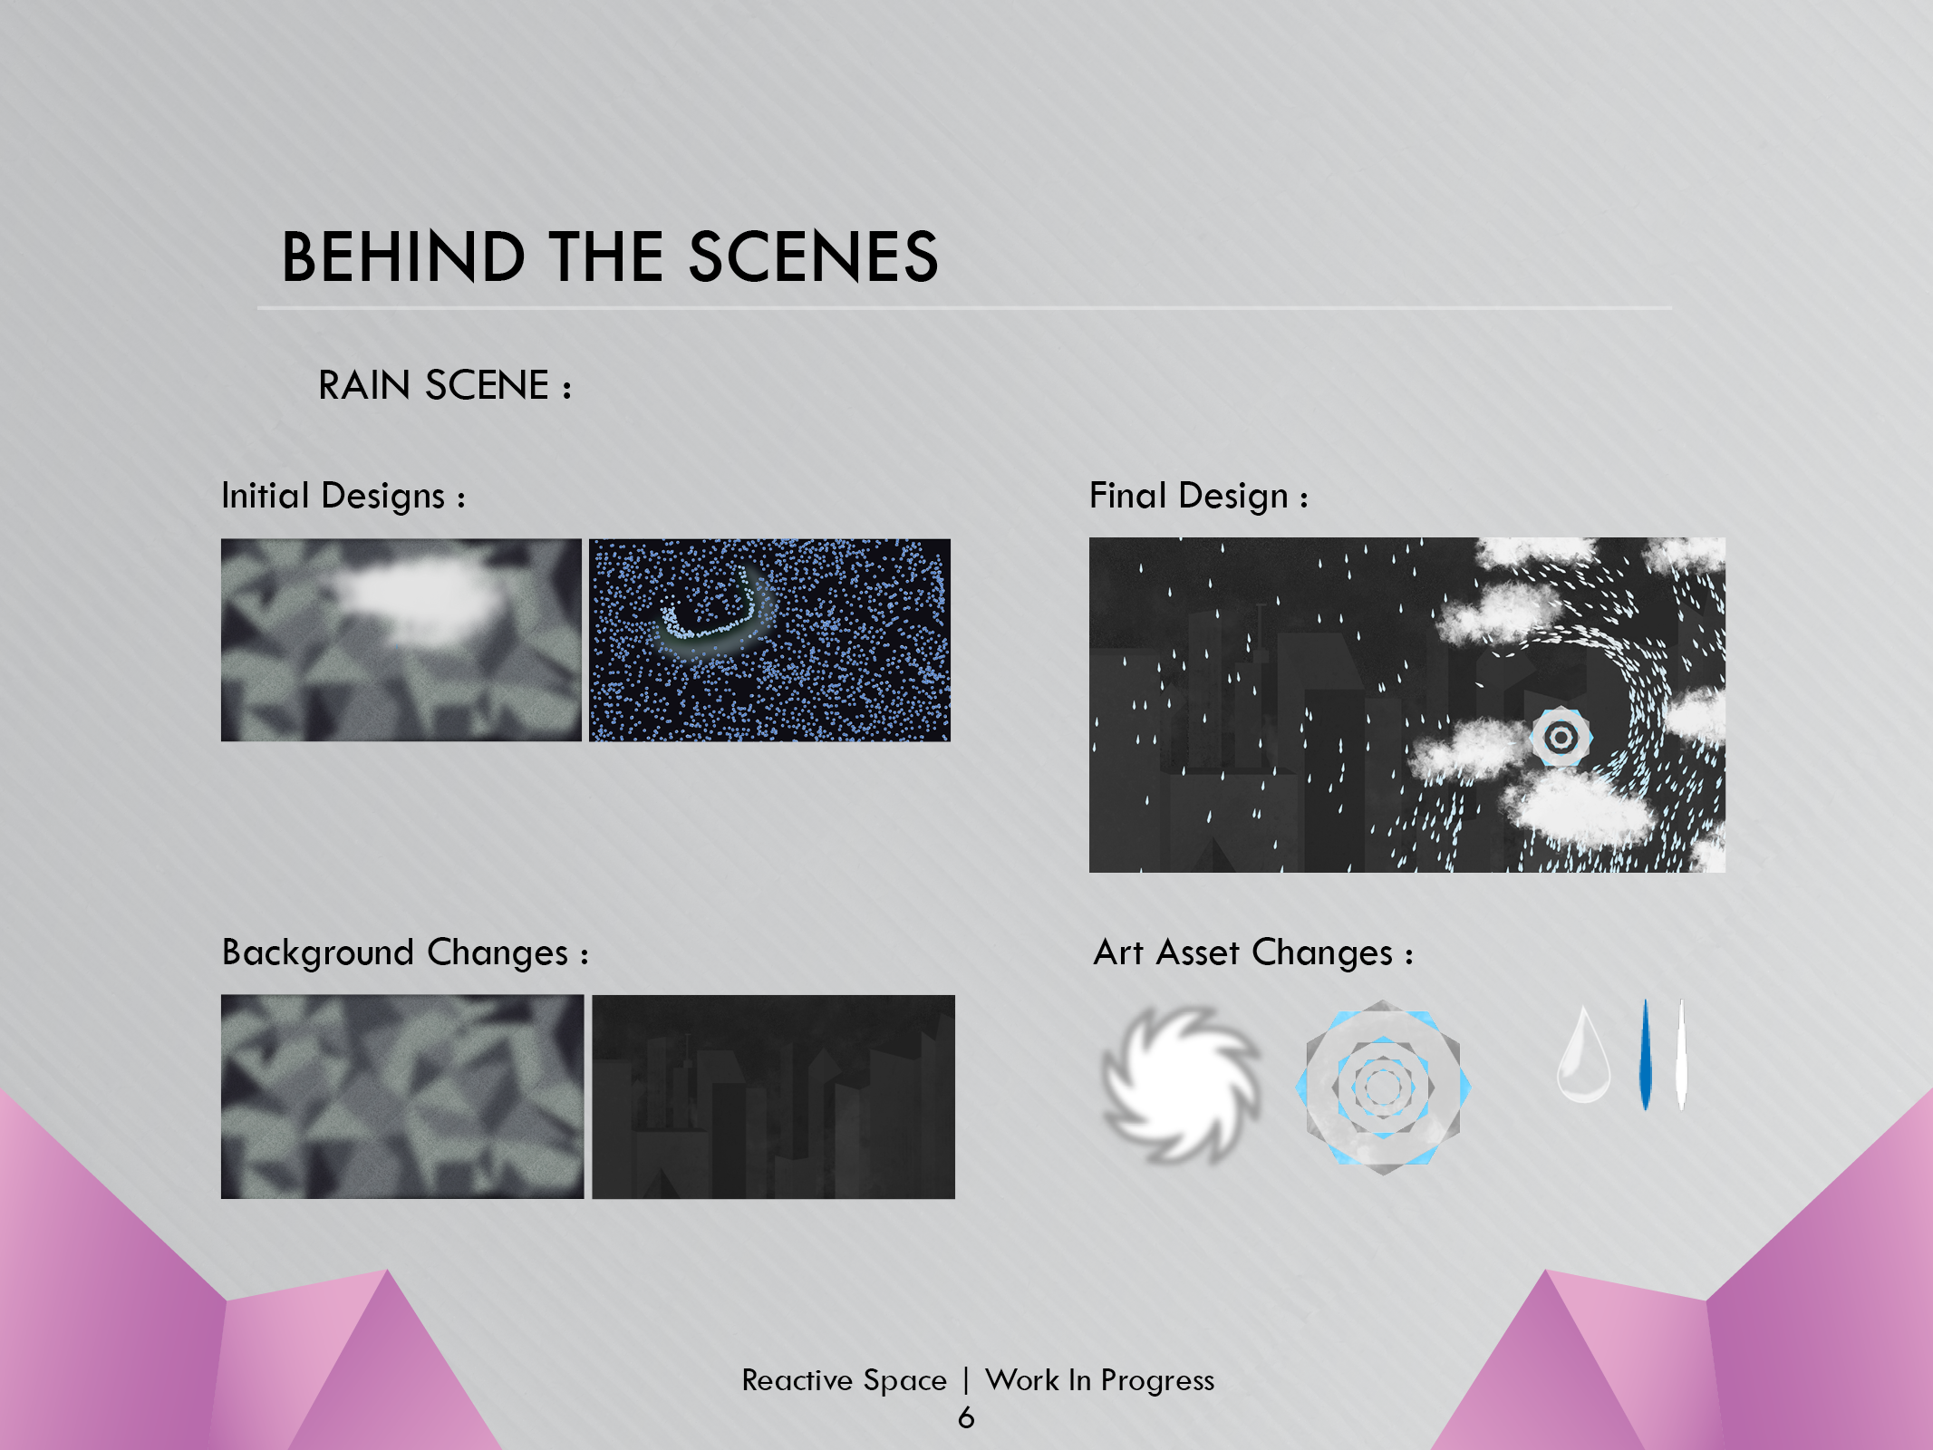
Notes:
Art
Lots of iterations
Different background/different idea from original
Idea for a city instead of an abstract background
Hand assets and rain also changed
Tech
Vector field
controls rain from hand movement
Hand movement affects vector field
Rain falls proportionally from clouds
13 minute

Slide 8
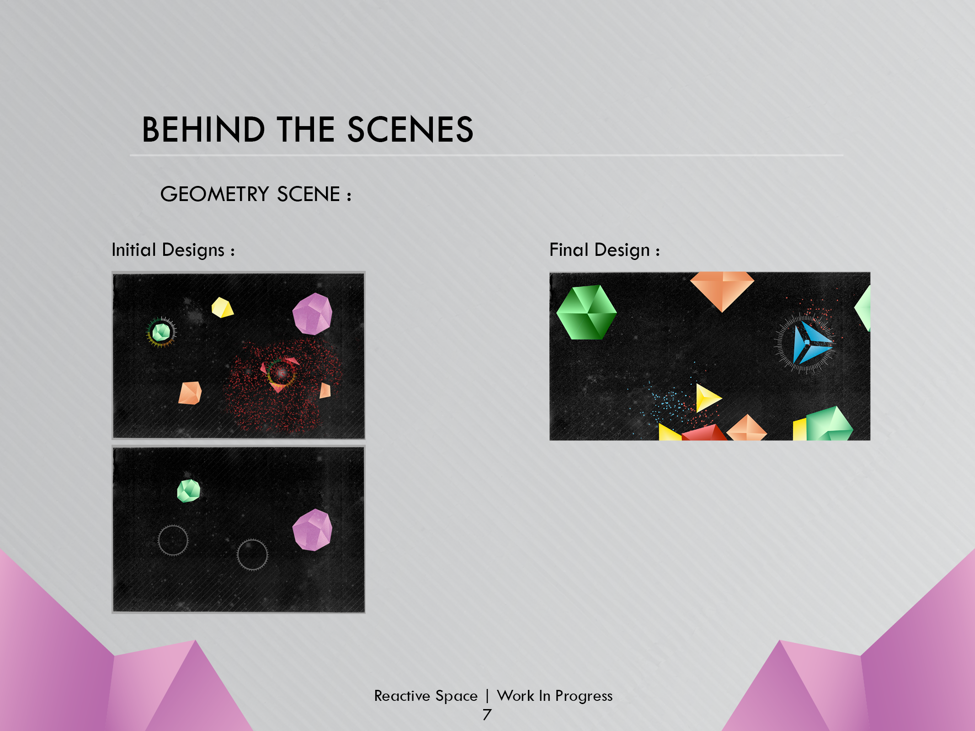
Notes:
Art
didn’t change much
only how hand timer colors are shown
Tech
Switched PNGs to mapped geometry
mapped to 3d geometry - Vertices
Separate hand class for time
trouble with hovering over two particles
14 minute

Slide 9
